Slide 1
Domestic abuse and child protection: Changing the conversation, making a difference for children and families
Change Project 2020-21
Facilitators: Kate Morris, Brid Featherstone & Sharon Inglis
Research in Practice Leads: Susannah Bowyer and Jessica Wild

Slide 2
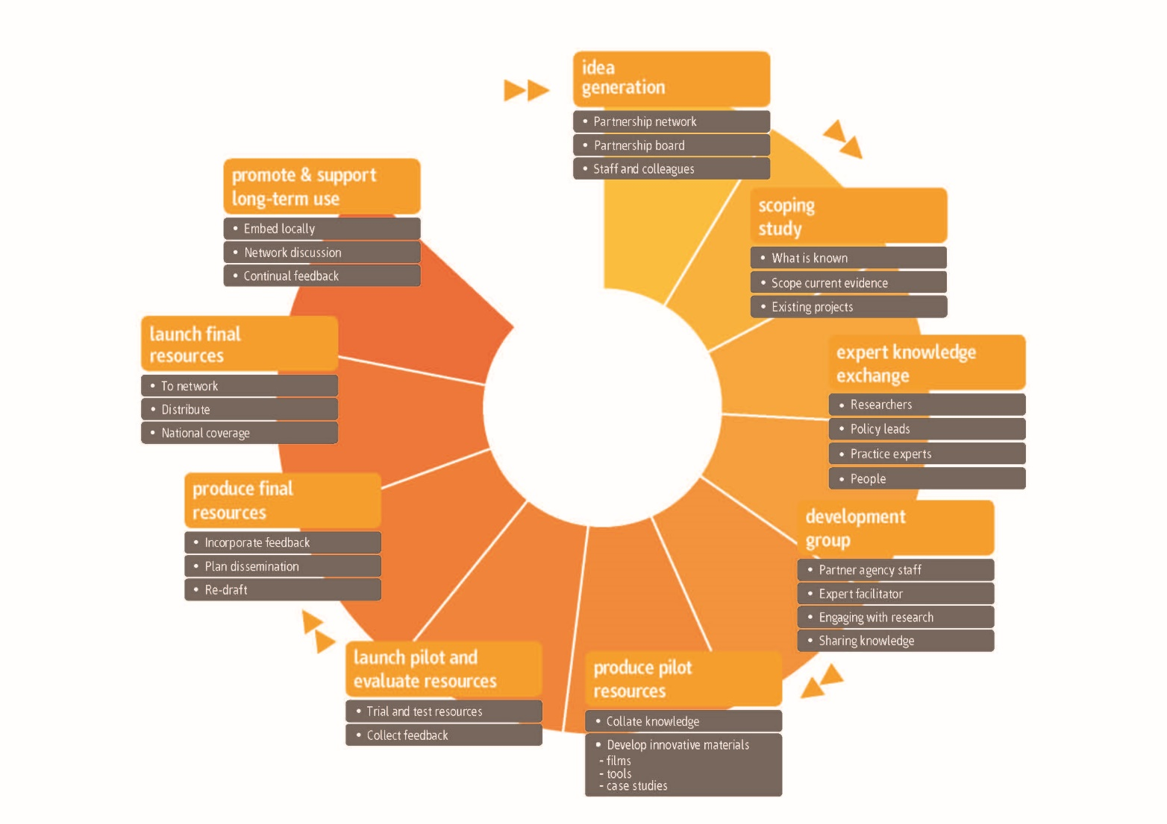
Research in Practice Change Projects
Notes:
SUSAN/ SUSANNAH:
Housekeeping and Filming and photography permission form
Change Projects bring together groups of Research in Practice Partners to explore pressing challenges and priorities. The project aims to support developments in child protection responses to concerns about domestic abuse (DA)
A development group, led by experts in the topic at hand, come together to learn from research and practice experience and formulate responses, solutions, tools, materials to support change in policy and practice.
Change Projects run for 18-24 months from inception to the launch of final resources.
Current Change Projects
Domestic abuse and child protection
We are working with Professor Kate Morris, Sheffield University, and Professor Brigid Featherstone and Paul Bywaters, Huddersfield University on this new Change Project which seeks to support new conceptual and practice developments when responding to families where there is domestic abuse. It will draw from international conceptual and practice developments, and family expertise to open up possibilities for re-thinking why domestic abuse is such a key driver of demand in child protection and how it might be responded to by approaches that are humane and socially transformative.
Improving organisational resilience in child and family social work
Led by Professor Gail Kinman and Dr Louise Grant from University of Bedfordshire, the aim of the project is to develop an accessible, research-informed diagnostic tool designed to assess the extent to which organisational factors and conditions support the wellbeing of their staff and promote optimum social work practice. An associated workbook will enable leaders to understand, build and sustain organisational resilience. We are exploring with the What Works Centre for Children’s Social Care the opportunity to pool our expertise and bring together two strands of work to produce a coherent offer to the sector on understanding and supporting organisational resilience.
Previous Change Projects
Working with recurrent care experienced birth mothers: Resource pack (2019)
An extensive online pack of evaluation tools, short films, animated power point slides to support the development of an emerging workforce. Developed in partnership with University of Lancaster and University of Essex
Towards a Cost Calculator for edge of care services (2018)
An initial exploration of the potential for developing data tools to enable the analysis of spend and outcomes for young people on the edge of care. Developed in partnership with Rees Centre, University of Oxford.
Reflective supervision: Resource Pack (2017)
A package of resources with tools to use in one-to one-and group supervision sessions. The outputs of a project in which practitioners and academics explored the theory and practice of reflective supervision.
Team-Based Learning – Assessing parental capacity to change: Training Course (2016)
Comprehensive training resources to support the development of skills and knowledge in assessing parental capacity to change.
Analysis and Critical Thinking in Assessment (2014)
The handbook includes key research and practice messages around analysis and critical thinking in assessment. It combines research evidence with the practice experience of agencies to explore how identified barriers to good assessment might be overcome.
Commissioning early help (2013)
Shifting resources away from managing crises to fund improved preventative and early help services. An overview of the key issues.
Evidence Matters in Family Justice (2012)
Beginning in 2004, this Change Project developed learning around social workers’ use of research in the family court. The resources were updated in 2012 to reflect emerging learning and significant family justice reforms.

Slide 3
Change Project primary research questions
The project drew from research, practice and family lived expertise to consider:
  Why has DVA become such a key driver of demand in child protection?
  How might our service responses be more humane, effective and socially transformative?

Slide 4
Change Project aims
To support new conceptual and practice developments when responding to families where there is Domestic Violence and or Abuse (DVA).
To radically reconceptualise dominant practice and policy approaches to DVA and child protection, to facilitate systems and culture change.
To produce outcomes and learning which will support practitioners and policy makers when supporting families where there is DVA, in order to enable better outcomes for children and whole families.

Slide 5
Development work
The Project supported participants from 30 local authorities, to explore how their child protection services currently understand and respond to concerns about DVA.
Participants completed a local case file audit to support the development of fresh approaches.
New research was discussed during each of the development days, as well as showcasing examples of innovative practice and presentations from mothers and fathers with lived experience.

Slide 6
Change Project development work
Themes covered during the project included:
  Understanding domestic abuse and typologies of domestic abuse
  Intersectionality and the role of poverty and inequalities in the lives of families who experience DVA
  Working with mothers who are experiencing DVA
  Working with men who harm in families
  Whole family approaches to DVA and child protection, including Safe & Together.
  Achieving and sustaining culture and systems change.

Slide 7
Planned resource outputs
Domestic abuse and child protection research digest series: 6 filmed resources featuring Brid Featherstone.
Case file audit key findings and national picture: written briefing and accompanying podcast with Brid Featherstone and Kate Morris.
Radically rethinking domestic abuse and child protection lived experience podcast series: co-produced with, and featuring, a mother who has worked with children’s social care and has experience of DVA.
Practice innovations series: case study interviews with practitioners from across the country showcasing new and innovative practice in the field of DVA and child protection.
Communities of practice: led by Brid Featherstone and Research in Practice, to embed and share learning.

Slide 8
Feedback from participants
“[T]he videos of the men and women's stories were very emotional and have stayed with me and really shifted my thinking about the work we need to do in DA and CP. I have used these to run training sessions with the staff in my DV Hub and it has evoked brilliant discussions.”

Slide 9
Feedback from participants
“[The Change Project] has really stimulated me to include the factors such as poverty in all communication and talk to social work teams about including them in the assessments. […] We have introduced the requirement for family network meetings and done more work on skills to work with fathers and helping people to acknowledge their fears and making plans to help them be less scared of approaching them.”

Slide 10
Feedback from participants
“The lived experience sessions brought home to me again the impact of institutional re-victimisation and [how] services have to follow a set process rather than listening , hearing and responding to need - and how at times practice/responses can be blinkered and sometimes miss the bigger picture of what is happening for those who are impacted upon by DA.”

